Slide 1
19CSE313 – Principles of Programming Languages
Concurrency in Java

Slide 2
concurrency
Ability to run several programs or several parts of a program in parallel.
A time consuming task can be performed asynchronously or in parallel
Improves the throughput and the interactivity of the program
A modern computer has several CPU’s or several cores within one CPU.
The ability to leverage these multi-cores can be the key for a successful high-volume application.

Slide 3
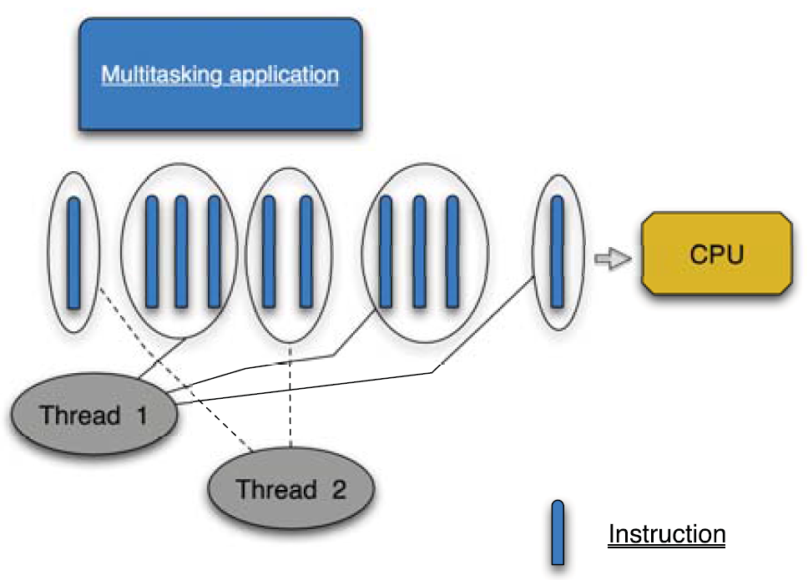
Concurrency
When more than one task can start and complete in overlapping time
periods
Need not be running in the same instant
Concurrent programs can be written on a single CPU too
Multiple tasks are executed in a time-slice manner, where a scheduler (such as the JVM) will guarantee each process a regular “slice” of operating time (Implemented using threads)
An Illusion of parallelism to users
A concurrent application running in a single
CPU core with two threads

Slide 4
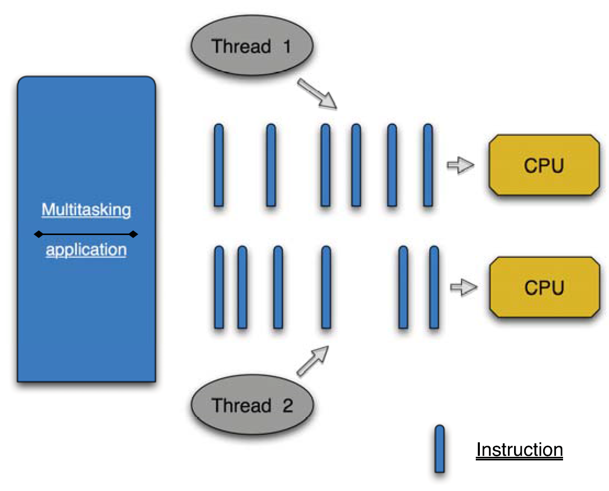
Concurrency vs parallel programming
In parallel programming), multiple tasks can be run at the same time, (possible with multicore processors)
A concurrent program sometimes becomes a parallel program when it’s running in a multicore environment.
Distributed computing: multiple computing nodes (computers, virtual machines) spanned across the network, working together on a given problem. A parallel process could be a distributed process when it’s running on multiple network nodes.
A concurrent and parallel application running in a two-CPU core with two threads. Both threads are running at the same time.

Slide 5
Process vs threads
Process | Thread
Runs independently and isolated of other processes | A thread is a so called lightweight process
Cannot directly access shared data in other processes | Has its own call stack, but can access shared data of other threads in the same process
The resources of the process, e.g. memory and CPU time, are allocated to it via the operating system. | Every thread has its own memory cache. If a thread reads shared data, it stores this data in its own memory cache. A thread can re-read the shared data
A Java application runs by default in one process.
Within a Java application you work with several threads to achieve parallel
processing or asynchronous behaviour.

Slide 6
Concurrency issues – Safety, Liveness, fairness
Threads have their own call stack, but can also access shared data.
Therefore there are two basic problems of visibility and access.
Visibility problem: occurs if thread A reads shared data which is later changed by thread B and thread A is unaware of this change.
Access problem: can occur if several threads access and change the same shared data at the same time.
Visibility and access problem can lead to:
Liveness failure: The program does not react anymore due to problems in the concurrent access of data, e.g. deadlocks.
Safety failure: The program creates incorrect data.
If a thread is not granted CPU time because other threads grab it all, it is called "starvation". The thread is "starved to death" because other threads are allowed the CPU time instead of it. The solution to starvation is called "fairness" - that all threads are fairly granted a chance to execute.

Slide 7
Causes of Starvation in Java
Threads with high priority swallow all CPU time from threads with lower priority.
Threads are blocked indefinitely waiting to enter a synchronized block, because other threads are constantly allowed access before it.
Threads waiting on an object (called wait() on it) remain waiting indefinitely because other threads are constantly awakened instead of it

Slide 8
Challenges with concurrent programming
Writing a correct, concurrent application or program. The correctness of the program is important.
Debugging multithreaded programs is difficult. The same program that causes deadlock in production might not have any locking issues when debugging locally. Sometimes threading issues show up after years of running in production.
Threading encourages shared state concurrency, and it’s hard to make programs run in parallel because of locks, semaphores, and dependencies between threads.

Slide 9
Multi-tasking vs multi-threading
Multitasking is when multiple processes share common processing resources such as a CPU
Multi-threading extends the idea of multitasking into applications where you can subdivide specific operations within a single application into individual threads.
Each of the threads can run in parallel.
The OS divides processing time not only among different applications, but also among each thread within an application.
Enables you to write in a way where multiple activities can proceed concurrently in the same program.
Java is a multi-threaded programming language which means we can develop multi-threaded program using Java.

Slide 10
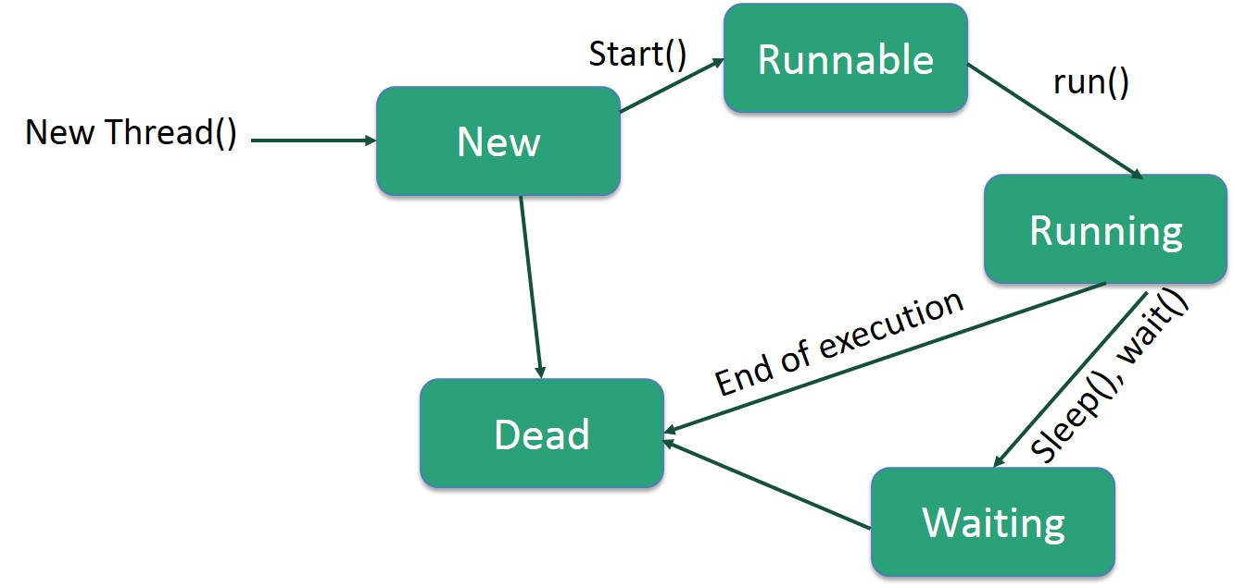
Life Cycle of a Thread
New – A thread begins its life cycle in this state
Runnable – After a New thread is started by the program, it becomes runnable
Waiting – A thread waits for another thread to perform a task. The thread transitions back to the runnable state only when the other thread signals the waiting thread to continue executing.
Timed Waiting - A runnable thread can enter the timed waiting state for a specified interval of time. A thread in this state transitions back to the runnable state when that time interval expires or when the event it is waiting for occurs.
Terminated (Dead) − A runnable thread enters the terminated state when it completes its task or terminates otherwise.

Slide 11
Thread Priorities
Java thread priorities range between MIN_PRIORITY (a constant of 1) and MAX_PRIORITY (a constant of 10).
By default, every thread is given priority NORM_PRIORITY (a constant of 5).
Threads with higher priority are more important to a program and should be allocated processor time before lower-priority threads.
However, thread priorities cannot guarantee the order in which threads execute and are very much platform dependent.

Slide 12
Create a Thread by Implementing a Runnable Interface (to execute your class as a thread)
Step 1
Implement public void run( ) method provided by runnable interface
This method provides an entry point for the thread and hence the complete execution logic is put inside this method.
Step 2
Instantiate a Thread object using the following constructor: Thread(Runnable threadObj, String threadName);
(threadObj is an instance of a class that implements the Runnable interface and threadName is the name given to the new thread)
Step 3
Once a Thread object is created, you can start it by calling void start() method, which executes a call to run( ) method.

Slide 13
Example to create a new thread and run it
class RunnableDemo implements Runnable {
private Thread t;
private String threadName;
RunnableDemo(String name) {
threadName = name;
System.out.println("Creating " + threadName );
}
public void run() {
System.out.println("Running " + threadName );
try {
for(int i = 4; i > 0; i--) {
System.out.println("Thread: " + threadName + ", " + i);
// Let the thread sleep for a while.
Thread.sleep(50);
}
} catch (InterruptedException e) {
System.out.println("Thread " + threadName + " interrupted.");
}
System.out.println("Thread " + threadName + " exiting.");
}
public void start () {
System.out.println("Starting " + threadName );
if (t == null) {
t = new Thread (this, threadName);
t.start ();
}
}
}

Slide 14
Testing the thread and output
public class TestThread {
public static void main(String args[]) {
RunnableDemo R1 = new RunnableDemo("Thread-1");
R1.start();
RunnableDemo R2 = new RunnableDemo("Thread-2");
R2.start();
}
}
D:\PPL\Java>javac TestThread.java
D:\PPL\Java>java TestThread
Creating Thread-1
Starting Thread-1
Creating Thread-2
Starting Thread-2
Running Thread-1
Running Thread-2
Thread: Thread-1, 4
Thread: Thread-2, 4
Thread: Thread-2, 3
Thread: Thread-1, 3
Thread: Thread-2, 2
Thread: Thread-1, 2
Thread: Thread-1, 1
Thread: Thread-2, 1
Thread Thread-1 exiting.
Thread Thread-2 exiting.

Slide 15
Create a Thread by Extending a Thread Class
Create a new class that extends Thread class by following two simple steps
The approach provides more flexibility in handling multiple threads created using available methods in Thread class.
Step 1
Override public void run( ) method available in Thread class which provides an entry point for the thread and put the complete computation logic in this method
Step 2
Once Thread object is created, start it by calling void start() method, which executes a call to run( ) method.

Slide 16
Example to create a new thread and run it
class ThreadDemo extends Thread {
private Thread t;
private String threadName;
ThreadDemo(String name) {
threadName = name;
System.out.println("Creating " + threadName );
}
public void run() {
System.out.println("Running " + threadName );
try {
for(int i = 4; i > 0; i--) {
System.out.println("Thread: " + threadName + ", " + i);
// Let the thread sleep for a while.
Thread.sleep(50);
}
} catch (InterruptedException e) {
System.out.println("Thread " + threadName + " interrupted.");
}
System.out.println("Thread " + threadName + " exiting.");
}
public void start () {
System.out.println("Starting " + threadName );
if (t == null) {
t = new Thread (this, threadName);
t.start ();
}
}
}

Slide 17
Testing the thread and output
public class TestThread1{
public static void main(String args[]) {
ThreadDemo T1 = new ThreadDemo("Thread-1");
T1.start();
ThreadDemo T2 = new ThreadDemo("Thread-2");
T2.start();
}
}
D:\PPL\Java>javac TestThread1.java
D:\PPL\Java>java TestThread1
Creating Thread-1
Starting Thread-1
Creating Thread-2
Starting Thread-2
Running Thread-1
Running Thread-2
Thread: Thread-1, 4
Thread: Thread-2, 4
Thread: Thread-1, 3
Thread: Thread-2, 3
Thread: Thread-1, 2
Thread: Thread-2, 2
Thread: Thread-1, 1
Thread: Thread-2, 1
Thread Thread-2 exiting.
Thread Thread-1 exiting.

Slide 18
Operations on threads
Sr.No. | Method | Description
1 | public void suspend() | This method puts a thread in the suspended state and can be resumed using resume() method.
2 | public void stop() | This method stops a thread completely.
3 | public void resume() | This method resumes a thread, which was suspended using suspend() method.
4 | public void wait() | Causes the current thread to wait until another thread invokes the notify().
5 | public void notify() | Wakes up a single thread that is waiting on this object's monitor.

Slide 19
Example
class ThreadOps implements Runnable {
public Thread t;
private String threadName;
boolean suspended = false;
ThreadOps(String name) {
threadName = name;
System.out.println("Creating " + threadName );
}
public void run() {
System.out.println("Running " + threadName );
try {
for(int i = 10; i > 0; i--) {
System.out.println("Thread: " + threadName + ", " + i);
// Let the thread sleep for a while.
Thread.sleep(300);
synchronized(this) {
while(suspended) {
wait();
}
}
}
} catch (InterruptedException e) {
System.out.println("Thread " + threadName + " interrupted.");
}
System.out.println("Thread " + threadName + " exiting.");
}
public void start () {
System.out.println("Starting " + threadName );
if (t == null) {
t = new Thread (this, threadName);
t.start ();
}
}
void suspend() {
suspended = true;
}
synchronized void resume() {
suspended = false;
notify();
}
}

Slide 20
Example
public class OpsTst {
public static void main(String args[]) {
ThreadOps R1 = new ThreadOps("Thread-1");
R1.start();
ThreadOps R2 = new ThreadOps("Thread-2");
R2.start();
try {
Thread.sleep(1000);
R1.suspend();
System.out.println("Suspending First Thread");
Thread.sleep(1000);
R1.resume();
System.out.println("Resuming First Thread");
R2.suspend();
System.out.println("Suspending thread Two");
Thread.sleep(1000);
R2.resume();
System.out.println("Resuming thread Two");
} catch (InterruptedException e) {
System.out.println("Main thread Interrupted");
} try {
System.out.println("Waiting for threads to finish.");
R1.t.join();
R2.t.join();
} catch (InterruptedException e) {
System.out.println("Main thread Interrupted");
}
System.out.println("Main thread exiting.");
}
}

Slide 21
Example
D:\PPL\Java>javac OpsTst.java
D:\PPL\Java>java OpsTst
Creating Thread-1
Starting Thread-1
Creating Thread-2
Starting Thread-2
Running Thread-1
Thread: Thread-1, 10
Running Thread-2
Thread: Thread-2, 10
Thread: Thread-2, 9
Thread: Thread-1, 9
Thread: Thread-2, 8
Thread: Thread-1, 8
Thread: Thread-1, 7
Thread: Thread-2, 7
Suspending First Thread
Thread: Thread-2, 6
Thread: Thread-2, 5
Thread: Thread-2, 4
Resuming First Thread
Thread: Thread-1, 6
Suspending thread Two
Thread: Thread-1, 5
Thread: Thread-1, 4
Thread: Thread-1, 3
Resuming thread Two
Thread: Thread-2, 3
Waiting for threads to finish.
Thread: Thread-1, 2
Thread: Thread-2, 2
Thread: Thread-1, 1
Thread: Thread-2, 1
Thread Thread-1 exiting.
Thread Thread-2 exiting.
Main thread exiting.

Slide 22
Thread pools (To execute tasks efficiently)
Single task execution using java.lang.Runnable is not efficient for a large number of tasks
A thread has to be created for each task
Could limit throughput and cause poor performance.
thread pool is an ideal way to manage the number of tasks executing concurrently.
Executor interface for executing tasks in a thread pool and the
ExecutorService interface for managing and controlling tasks in Java

Slide 23
Synchronization and locks
A shared resource may become corrupted if it is accessed simultaneously by multiple threads.
Example:
Consider an application that creates and launches 100 threads
Each thread adds a rupee to an account
Classes Required for the above application:
Define a class named Account to model the account,
a class named AddAPennyTask to add a penny to the account, and
a main class that creates and launches threads.

Slide 24
import java.util.concurrent.*;
public class AccountWithoutSync {
private static Account account = new Account();
public static void main(String[] args) {
ExecutorService executor = Executors.newCachedThreadPool(); //create executor
// Create and launch 100 threads
for (int i = 0; i < 100; i++) {
executor.execute(new AddAPennyTask()); //submit task
}
executor.shutdown(); //shut down executor
// Wait until all tasks are finished
while (!executor.isTerminated()) { //wait for all tasks to //terminate
}
System.out.println("What is balance? " + account.getBalance());
}
// A thread for adding a penny to the account
private static class AddAPennyTask implements Runnable {
public void run() {
account.deposit(1);
}
}
// An inner class for account
private static class Account {
private int balance = 0;
public int getBalance() {
return balance;
}
public void deposit(int amount) {
int newBalance = balance + amount;
// This delay is deliberately added to magnify the
// data-corruption problem and make it easy to see.
try {
Thread.sleep(5);
}
catch (InterruptedException ex) {
}
balance = newBalance;
}
}
}
D:\PPL\Java>java AccountWithoutSync
What is balance? 3
D:\PPL\Java>java AccountWithoutSync
What is balance? 2
D:\PPL\Java>java AccountWithoutSync
What is balance? 3
D:\PPL\Java>java AccountWithoutSync
What is balance? 2
D:\PPL\Java>java AccountWithoutSync
What is balance? 2
D:\PPL\Java>java AccountWithoutSync
What is balance? 3

Slide 25
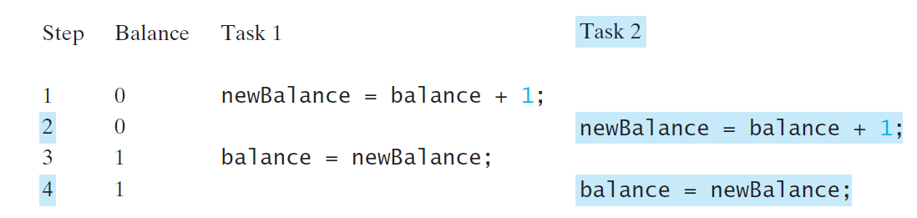
Race condition in multithreaded programs
Task 1 and Task 2 both add 1 to the same balance
In Step 1, Task 1 gets the balance from the account.
In Step 2, Task 2 gets the same balance from the account.
In Step 3, Task 1 writes a new balance to the account.
In Step 4, Task 2 writes a new balance to the account.
The effect of this scenario is that Task 1 does nothing because in Step 4
Task 2 overrides Task 1’s result.
The problem is that Task 1 and Task 2 are accessing a common resource in a way that causes a conflict.

Slide 26
The synchronized Keyword
Used to access the critical region (E.g., deposit method) by only one thread at a time using
public synchronized void deposit(double amount)
A synchronized method acquires a lock before it executes.
Lock
A mechanism for exclusive use of a resource
For instance method, the lock is on the object for which the method was invoked
For static method, the lock is on the class
If one thread invokes a synchronized instance method (respectively, static method) on an object, the lock of that object (respectively, class) is acquired first, then the method is executed, and finally the lock is released.
Another thread invoking the same method of that object (respectively, class) is blocked until the lock is released.

Slide 27
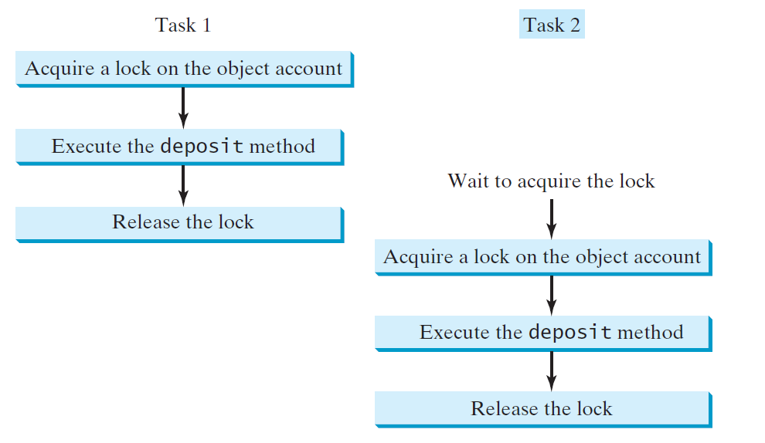
Deposit after synchronisation

Slide 28
Synchronised statement / block
synchronized (expr) {
statements;
}
The expression expr must evaluate to an object reference.
Example:
synchronized (account) {
account.deposit(1);
}
If the object is already locked by another thread, the thread is blocked until the lock is released.
When a lock is obtained on the object, the statements in the synchronized block are executed and then the lock is released.

Slide 29
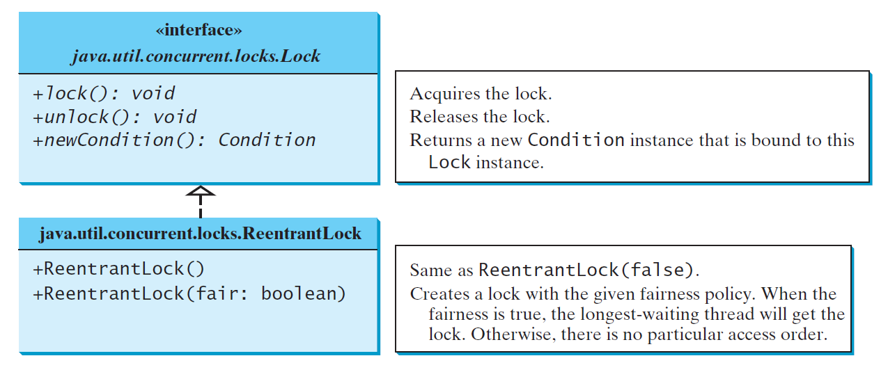
Synchronization using locks in java
Lock: instance of the Lock interface - defines the methods for acquiring and releasing locks
newCondition() method: to create any number of Condition objects - can be used for thread communications
ReentrantLock: concrete implementation of Lock - creating mutually exclusive locks.
Fairness Policy:
True – guarantees that the longest-waiting thread will obtain the lock first.
False – grants a lock to a waiting thread arbitrarily.
Programs using fair locks accessed by many threads may have poorer overall performance than those using the default setting, but they have smaller variances in times to obtain locks and prevent starvation.

Slide 30
import java.util.concurrent.*;
import java.util.concurrent.locks.*;
public class AccountWithSyncUsingLock {
private static Account account = new Account();
public static void main(String[] args) {
ExecutorService executor = Executors.newCachedThreadPool();
// Create and launch 100 threads
for (int i = 0; i < 100; i++) {
executor.execute(new AddAPennyTask());
}
executor.shutdown();
// Wait until all tasks are finished
while (!executor.isTerminated()) {
}
System.out.println("What is balance? " + account.getBalance());
}
// A thread for adding a penny to the account
public static class AddAPennyTask implements Runnable {
public void run() {
account.deposit(1);
}
}
// An inner class for Account
public static class Account {
private static Lock lock = new ReentrantLock(); // Create a lock
private int balance = 0;
public int getBalance() {
return balance;
}
public void deposit(int amount) {
lock.lock(); // Acquire the lock
try {
int newBalance = balance + amount;
// This delay is deliberately added to magnify the
// data-corruption problem and make it easy to see.
Thread.sleep(5);
balance = newBalance;
}
catch (InterruptedException ex) {
}
finally {
lock.unlock(); // Release the lock
}
}
}
}
D:\PPL\Java>javac AccountWithSyncUsingLock.java
D:\PPL\Java>java AccountWithSyncUsingLock
What is balance? 100
D:\PPL\Java>java AccountWithSyncUsingLock
What is balance? 100
D:\PPL\Java>java AccountWithSyncUsingLock
What is balance? 100
D:\PPL\Java>java AccountWithSyncUsingLock
What is balance? 100
D:\PPL\Java>java AccountWithSyncUsingLock
What is balance? 100

Slide 31
Future and callable
Runnable interface can only run the thread
In contrast, java.util.concurrent.Callable object can return the computed result done by a thread
Callable object:
returns Future object which provides methods to monitor the progress of a task being executed by a thread.
Future object:
can be used to check the status of a Callable and then retrieve the result from the Callable once the thread has completed execution
Also provides timeout functionality

Slide 32
Future and callable - syntax
//submit the callable using ThreadExecutor and get the result as a Future object
Future<Long> result10 = executor.submit(new FactorialService(10));
//get the result using get method of the Future object
//get method waits till the thread execution and then return the result of the execution.
Long factorial10 = result10.get();

Slide 33
Example
import java.util.concurrent.Callable;
import java.util.concurrent.ExecutionException;
import java.util.concurrent.ExecutorService;
import java.util.concurrent.Executors;
import java.util.concurrent.Future;
public class FutCall {
public static void main(final String[] arguments) throws InterruptedException,
ExecutionException {
ExecutorService executor = Executors.newSingleThreadExecutor();
System.out.println("Factorial Service called for 10!");
Future<Long> result10 = executor.submit(new FactorialService(10));
System.out.println("Factorial Service called for 20!");
Future<Long> result20 = executor.submit(new FactorialService(20));
Long factorial10 = result10.get();
System.out.println("10! = " + factorial10);
Long factorial20 = result20.get();
System.out.println("20! = " + factorial20);
executor.shutdown();
}
static class FactorialService implements Callable<Long> {
private int number;
public FactorialService(int number) {
this.number = number;
}
@Override
public Long call() throws Exception {
return factorial();
}
private Long factorial() throws InterruptedException {
long result = 1;
while (number != 0) {
result = number * result;
number--;
Thread.sleep(100);
}
return result;
}
}
}

Slide 34
Example - output
D:\PPL\Java>javac FutCall.java
D:\PPL\Java>java FutCall
Factorial Service called for 10!
Factorial Service called for 20!
10! = 3628800
20! = 2432902008176640000

Slide 35
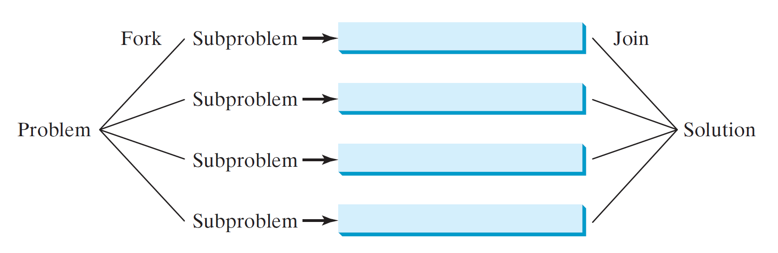
Parallel Programming
The Fork/Join Framework is used for parallel programming in Java.
A problem is divided into non-overlapping sub-problems, which can be solved independently in parallel.
A fork can be viewed as an independent task that runs on a thread
The solutions to all sub-problems are then joined to obtain an overall solution for the problem.
A parallel implementation of the divide-and-conquer approach.

Slide 36
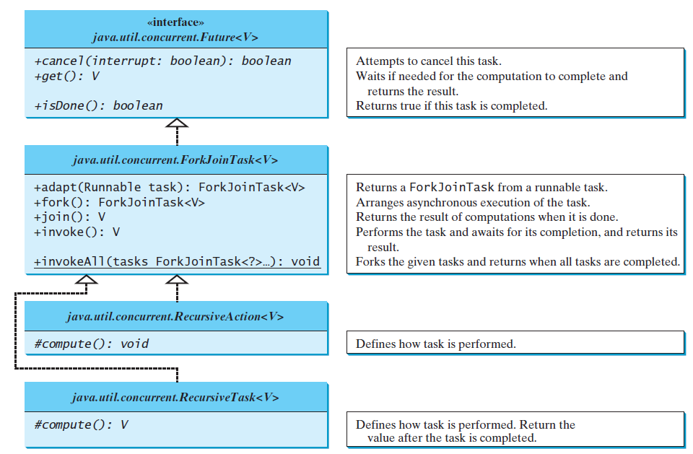
Fork-Join Task (defines a task for asynchronous execution)

Slide 37
Fork-JoinTask class
Abstract base class for tasks
Is a thread-like entity, but it is much lighter than a normal thread because huge numbers of tasks and subtasks can be executed by a small number of actual threads in a ForkJoinPool
Tasks are primarily coordinated using fork() and join().
Invoking fork() on a task arranges asynchronous execution
Invoking join() waits until the task is completed
invoke() and invokeAll(tasks) methods implicitly invoke fork() to execute the task and join() to wait for the tasks to complete, and return the result, if any
The static method invokeAll takes a variable number of ForkJoinTask arguments using the ... syntax

Slide 38
Fork-Join framework
Fork-join framework
designed to parallelize naturally recursive divide-and-conquer solutions
allows to break a certain task on several workers and then wait for the result to combine them.
It leverages multi-processor machine's capacity to great extent.
Fork
a process in which a task splits itself into smaller and independent sub-tasks which can be executed concurrently
Syntax:
Sum left = new Sum(array, low, mid);
left.fork();
where Sum is a subclass of RecursiveTask and left.fork() splits the task into sub-tasks.

Slide 39
Fork-Join framework
Join
A process in which a task join all the results of sub-tasks once the subtasks have finished executing, otherwise it keeps waiting.
Syntax:
left.join();
were left is an object of Sum class.

Slide 40
ForkJoinPool
a special thread pool designed to work with fork-and-join task splitting
Syntax
ForkJoinPool forkJoinPool = new ForkJoinPool(4);
Here a new ForkJoinPool is created with a parallelism level of 4 CPUs.

Slide 41
Recursive action and recursive task
Two subclasses of ForkJoinTask
To define a concrete task class, your class should extend RecursiveAction or RecursiveTask
Your task class should override the compute() method to specify how a task is performed.
Recursive Action:
represents a task which does not return any value
Syntax
class Writer extends RecursiveAction {
@Override
protected void compute() { }
}
Recursive Task:
represents a task which returns a value
Syntax
class Sum extends RecursiveTask<Long> {
@Override protected Long compute() { return null; }
}

Slide 42
Example
import java.util.concurrent.ExecutionException;
import java.util.concurrent.ForkJoinPool;
import java.util.concurrent.RecursiveTask;
public class ForkJoin {
public static void main(final String[] arguments) throws InterruptedException,
ExecutionException {
int nThreads = Runtime.getRuntime().availableProcessors();
System.out.println(nThreads);
int[] numbers = new int[1000];
for(int i = 0; i < numbers.length; i++) {
numbers[i] = i;
}
ForkJoinPool forkJoinPool = new ForkJoinPool(nThreads);
Long result = forkJoinPool.invoke(new Sum(numbers,0,numbers.length));
System.out.println(result);
}
static class Sum extends RecursiveTask<Long> {
int low;
int high;
int[] array;
Sum(int[] array, int low, int high) {
this.array = array;
this.low = low;
this.high = high;
}
protected Long compute() {
if(high - low <= 10) {
long sum = 0;
for(int i = low; i < high; ++i)
sum += array[i];
return sum;
} else {
int mid = low + (high - low) / 2;
Sum left = new Sum(array, low, mid);
Sum right = new Sum(array, mid, high);
left.fork();
long rightResult = right.compute();
long leftResult = left.join();
return leftResult + rightResult;
}
}
}
}

Slide 43
Example - output
D:\PPL\Java>java ForkJoin
4
499500

Slide 44
Thank you

